Slide 1

Windows downgrade update
CVE-2024-21302

Slide 2
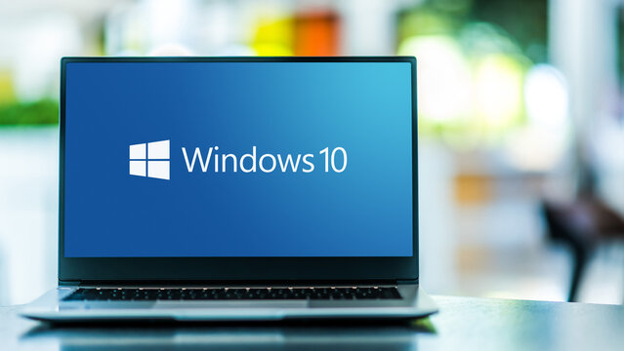

Product INTRODUCTION
During the course of this presentation we will be focusing on Virtualization-Based Security (VBS).
VBS uses Hardware virtualization and the Windows hypervisor to create an isolated virtual enviroment. This allows the use of isolated enviroments to host several security solutions without compromising the operative system.

Slide 3
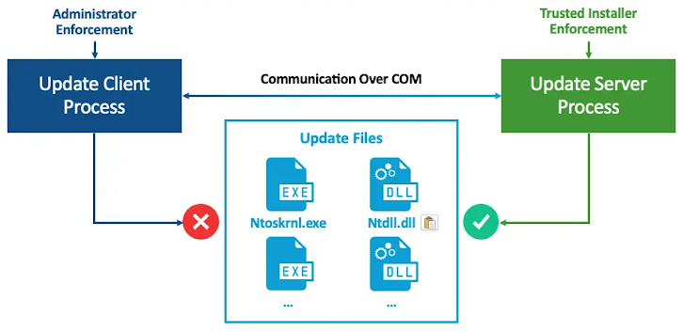
CVE-2024-21302 - Introduction
The vulnerability (CVE-2024-21302) allows an attacker to manipulate the Windows Update process to stealthily downgrade a fully patched Windows system to an older, vulnerable state. This reintroduces previously resolved security flaws, turning them into exploitable zero-day vulnerabilities once again.

Slide 4
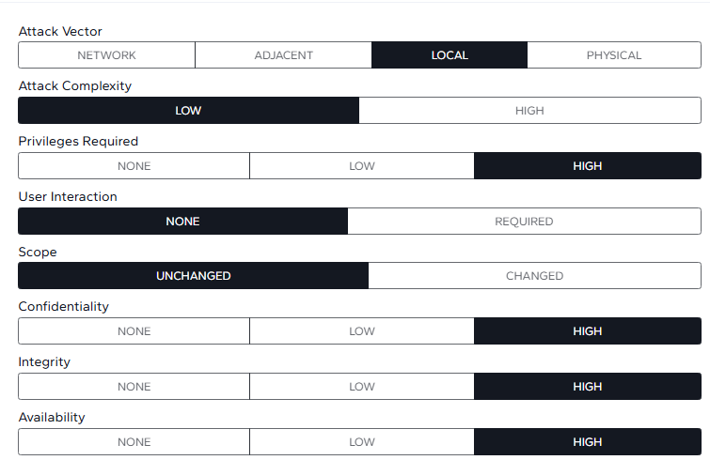
CVE-2024-21302 - Introduction
According with SafeBreach security researcher Alon Leviev, with the use of the tool Windows Downdate its possible for an attacker with administrator privileges to replace current versions of Windows system files, outdated versions. By leveraging this vulnerability, an attacker could reintroduce previously addressed vulnerabilities, bypass certain VBS protections, and exfiltrate data safeguarded. Using the Common Vulnerability Scoring System (CVSS) is 6.7 (Medium)

Slide 5

Aug. 08, 2024
Aug. 12, 2024
Aug. 13, 2024
Sep. 18, 2024
CVE Received by secure@microsoft.com
CVE Modified by secure@microsoft.com
Initial Analysis by nvd@nist.gov
CVE Modified by secure@microsoft.com
The vulnerability was reported by the researcher mentioned previously, Alon Leviev, during the Black Hat 2024, a premier conference on information security.
It is now known to affect Windows 10, 11, and several Windows Server versions.
Microsoft recommends auditing file access and sensitive privileges, monitoring risky accounts, and enforcing multi-factor authentication
Microsoft encourages customers to subscribe to the newly developed Security Update Guide and enable notifications for it
Microsoft releases an opt-in mitigation (KB5042562)

Slide 6
CVE-2024-21302 – Discovery and mitigations
At the time of writing this work there isn't an official patch, although Microsoft has released opt-in mitigation, that allowed to reduce the overall risk, in order to follow the recommended actions, the user should:
Deploy a Microsoft-signed revocation policy (SkuSiPolicy.p7b), this allowed to block vulnerable, unpatched versions of VBS system files from being loaded by the operating system.
In order to be able to detect this vulnerability, a detection has been added to Microsoft Defender for Endpoint (MDE) to alert customers using this product of an exploit attempt
Yet Microsoft warns users that the opt-in mitigation carries its own risk, and that precautions should be taken.
Precautions like regular file-system audits and enforcing regular policy updates.

Slide 7
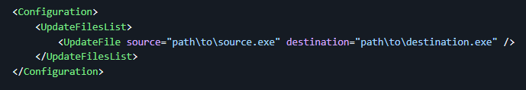
CVE-2024-21302 – Proof of concept (poc)
To be able to exploit this CVE we need 2 python libraries:
pywin32 – This allows to interact with Windows API, to access a variety of services, processes, windows and registers.
psutil – Provides an interface to obtain information about the processes and resources of the system.
Both of this libraries can be found in the requirements.txt, and installed with the command pip install -r requirements.txt found in the github page present in the bibliography.
This operates with a configuration XML file that specifies the files to downgrade.
The most important aspect of this file are the source and destination tags, since the file that is under the source will replace the file in destination.

Slide 8

CVE-2024-21302 - Proof of concept (poc)
https://www.safebreach.com/wp-content/uploads/2024/08/Credential-Extraction-PPL-and-UEFI-Lock-Bypass.mp4

Slide 9
bibliography
CVE-2024-21302 - Security Update Guide - Microsoft - Windows Secure Kernel Mode Elevation of Privilege Vulnerability
Windows Downgrade Attack Risks Exposing Patched Systems to Old Vulnerabilities (thehackernews.com)
Downgrade Attacks Using Windows Updates | SafeBreach
PoC Exploit Released for Windows 0-Day Downgrade Attack (cybersecuritynews.com)
https://nvd.nist.gov/vuln/detail/CVE-2024-21302
https://www.techtarget.com/searchenterprisedesktop/definition/virtualization-based-security-VBS
https://learn.microsoft.com/en-us/windows-hardware/design/device-experiences/oem-vbs
https://techcommunity.microsoft.com/t5/windows-it-pro-blog/achieving-world-class-windows-monthly-patching-efficiency/ba-p/2572945
KB5042562: Guidance for blocking rollback of Virtualization-based Security (VBS) related security updates - Microsoft Support
CVE-2024-21302 - Microsoft Windows Virtualization Based Security Elevation of Privilege Vulnerability (cvefeed.io)
pywin32 · PyPI
psutil · PyPI
SafeBreach-Labs/WindowsDowndate: A tool that takes over Windows Updates to craft custom downgrades and expose past fixed vulnerabilities (github.com)

